Slide 1
The SynPuter Project
Status Update + Mitigation Plan
Tahmeed Waes Ali

Slide 2
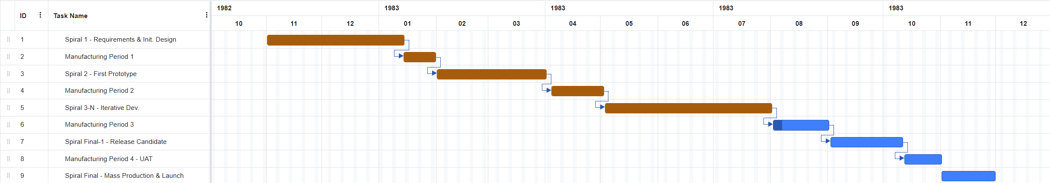
Progress per current plan:

Slide 3
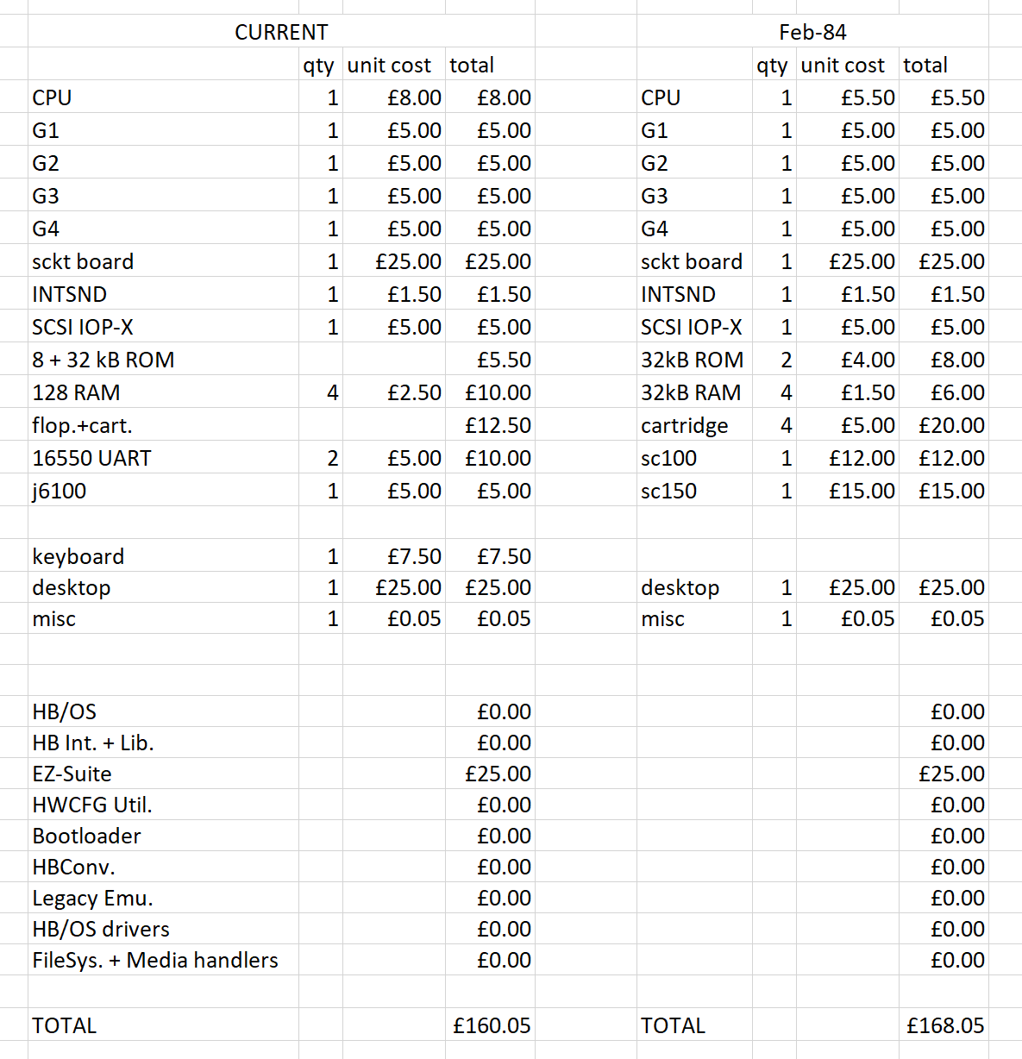
Current Designs

Slide 4
EDC’s requirements
Industry-standard operating system
External keyboard / connector
At least 512 kB of RAM
At least 1 industry-standard drive w/ removable media
SCSI expansion capability
At least a 68k CPU – preferably upgradable
Min. of 2 serial ports supporting RS 422/485 standard (network-capable)
A board ready to support a GUI system and mouse if required

Slide 5
EDC’s requirements
HyperBasic OS (HB/OS)
HyperBasic Interpreter
Can export files to other software
Industry-standard operating system
External keyboard / connector
At least 512 kB of RAM
At least 1 industry-standard drive w/ removable media
SCSI expansion capability
At least a 68k CPU – preferably upgradable
Min. of 2 serial ports supporting RS 422/485 standard (network-capable)
A board ready to support a GUI system and mouse if required

Slide 6
EDC’s requirements
Original model has ext. keyboard; evaluation model does not
Compromise: sell this computer as two models - a standard and professional version
Industry-standard operating system
External keyboard / connector
At least 512 kB of RAM
At least 1 industry-standard drive w/ removable media
SCSI expansion capability
At least a 68k CPU – preferably upgradable
Min. of 2 serial ports supporting RS 422/485 standard (network-capable)
A board ready to support a GUI system and mouse if required

Slide 7
EDC’s requirements
Industry-standard operating system
External keyboard / connector
At least 512 kB of RAM
At least 1 industry-standard drive w/ removable media
SCSI expansion capability
At least a 68k CPU – preferably upgradable
Min. of 2 serial ports supporting RS 422/485 standard (network-capable)
A board ready to support a GUI system and mouse if required
Original: 4x 128 = 512 kB RAM
Evaluation: 4x 32 = 128 kB RAM
Original config for the EDC version

Slide 8
EDC’s requirements
Industry-standard operating system
External keyboard / connector
At least 512 kB of RAM
At least 1 industry-standard drive w/ removable media
SCSI expansion capability
At least a 68k CPU – preferably upgradable
Min. of 2 serial ports supporting RS 422/485 standard (network-capable)
A board ready to support a GUI system and mouse if required
Original has a floppy / cartridge combo;
Evaluation has 4 cartridges
[board has 2 cart. Slots]

Slide 9
EDC’s requirements
Industry-standard operating system
External keyboard / connector
At least 512 kB of RAM
At least 1 industry-standard drive w/ removable media
SCSI expansion capability
At least a 68k CPU – preferably upgradable
Min. of 2 serial ports supporting RS 422/485 standard (network-capable)
A board ready to support a GUI system and mouse if required
Both have these

Slide 10
EDC’s requirements
Industry-standard operating system
External keyboard / connector
At least 512 kB of RAM
At least 1 industry-standard drive w/ removable media
SCSI expansion capability
At least a 68k CPU – preferably upgradable
Min. of 2 serial ports supporting RS 422/485 standard (network-capable)
A board ready to support a GUI system and mouse if required
Original: 68000, socketed
Evaluation: 68008, soldered

Slide 11
EDC’s requirements
Industry-standard operating system
External keyboard / connector
At least 512 kB of RAM
At least 1 industry-standard drive w/ removable media
SCSI expansion capability
At least a 68k CPU – preferably upgradable
Min. of 2 serial ports supporting RS 422/485 standard (network-capable)
A board ready to support a GUI system and mouse if required
Original: 2 ports (16550 UART)
Evaluation: 1 port (SC100)
Needs testing

Slide 12
EDC’s requirements
Industry-standard operating system
External keyboard / connector
At least 512 kB of RAM
At least 1 industry-standard drive w/ removable media
SCSI expansion capability
At least a 68k CPU – preferably upgradable
Min. of 2 serial ports supporting RS 422/485 standard (network-capable)
A board ready to support a GUI system and mouse if required
Low requirement even by EDC
Future-facing

Slide 13
Model Comparison
Component | Standard model (sold by Synful) | Professional model (sold by EDC)
OS + software | HB/OS + HyperBasic Interpreter + EZ-Suite (+ optional DOS tools) [+optional SynEM for legacy Synful systems]
CPU | Motorola 68k8 | Motorola 68k
ROM | 8 kB bootloader + 32 kB OS | 32 kB bootloader + 32 kB OS
RAM | 128 kB ( = 4x 32 kB) | 512 kB ( = 4x 128 kB)
Storage | 2 Cartridges | 4 Cartridges (2 slots, load as needed)
Expandable? | Yes, w/ separately sold expansion card | Yes, w/ floppies and/or exp. card
Serial/Net. Ports | Yes…? Needs testing to confirm, but should be easily rectifiable
GUI/mouse | No GUI [unless DOS tools selected]; mouse possible depending on available port
Est. cost | £165.55 | £162.55

Slide 14
Feb84 Evaluation Machine Troubleshooting
Known Issues:
HB/OS crashes if logging media is unavailable
Check that writable media has been installed
Limit memory load
Failing that, disconnect the OS cartridge if already connected; reconnect
Random resets from electromagnetic interference from the cartridge drives
Avoid swapping drives out during operation
Ensure peripherals are properly grounded
Memory constraints under multitasking workloads
Disable non-essential background services
Limit concurrent applications
Configuration lost on reboot?
Document configurations for repeat testing
Reapply configuration parameters after power cycling
Persistent storage planned for production config

Slide 15
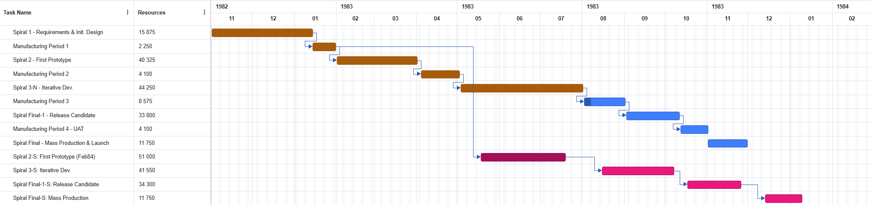
Updated Timeline
Labour Cost (£)
Total Labour Cost (£)
303 625
Material cost:
2000x £162.55 = £325,100 prof.
3000x £165.55 = £496,650 stand.
TOTAL: £821,750
Possible delay due to personnel reshuffling
Ideal delivery time for professional model – ~31/Dec/1983
For standard model - ~15/Jan/1984
Total Revenue: 3000x £399 = £1,197,000
Profit: £1,197,000 + (£821,750) + (£303,625) = £71,625

Slide 16
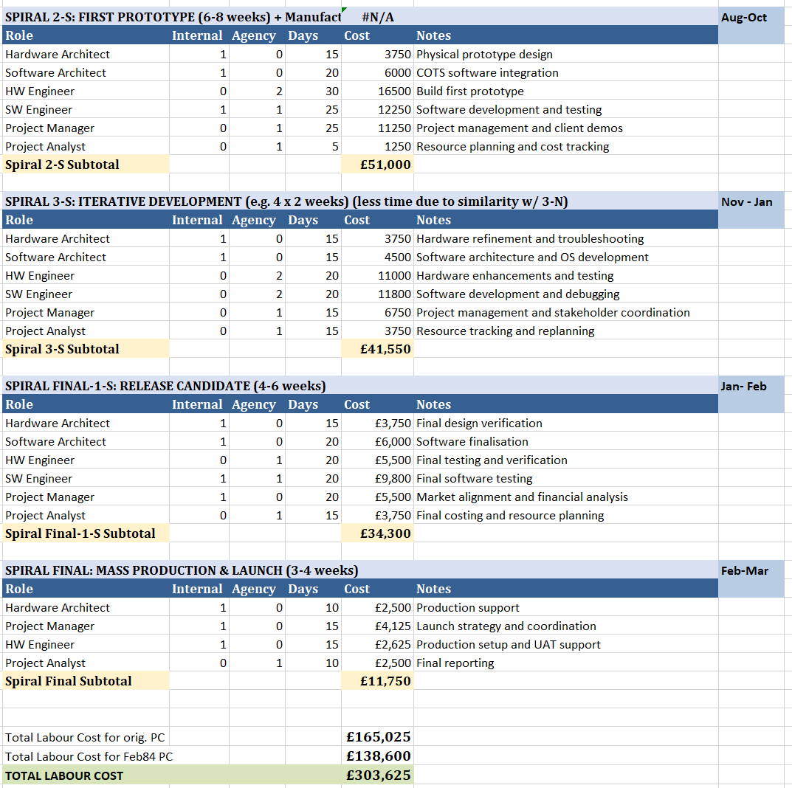
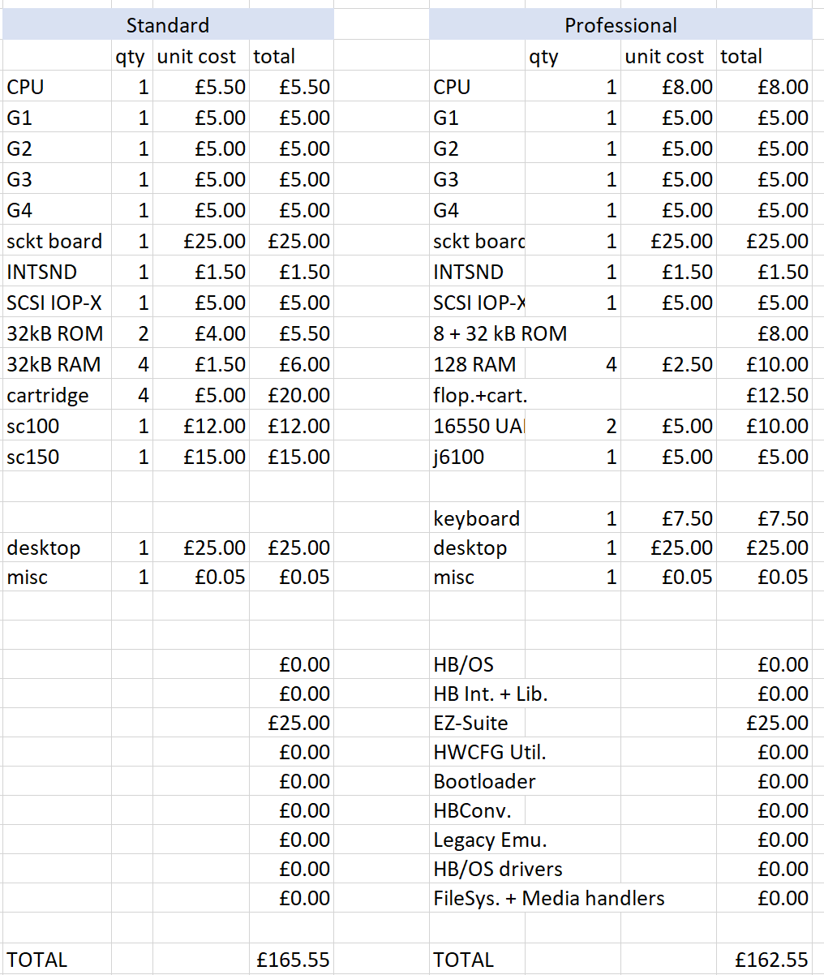
Thank you
Appendix B: extra labour costs
Appendix A: material costs

Slide 17
References
BBC BASIC (n.d.) The Website Dedicated to the BBC BASIC Programming Language. Available at: https://www.bbcbasic.co.uk/bbcbasic.html [Accessed: 19th January 2026]
Cohen, P (2017) A History of Removable Computer Storage. Available at: https://www.backblaze.com/blog/history-removable-computer-storage/ [Accessed: 19th January 2026]
IBM (2021) BASIC Language Reference. Available at: https://www.ibm.com/docs/en/iis/11.5.0?topic=reference-basic-language [Accessed: 19th January 2026]
TME (2025) Electromagnetic Interference (EMI): Identification and Prevention Methods in Electronics. Available at: https://www.tme.eu/gb/news/library-articles/page/68660/electromagnetic-interference-emi-identification-and-prevention-methods-in-electronics/ [Accessed: 19th January 2026]
Kavinda, L. (2021) Interfaces in the 80s: Creating GUIs before it was cool. Accessible at: https://uxdesign.cc/creating-guis-before-it-was-cool-57473c96cd6b [Accessed: 19th January 2026]

